Slide 1

Analysis of Leading Causes of Death in the United States (1999–2017)
Tabular Data + Map & Aggregation Visualization
Course: CSIT 553 – Exploratory Data Analysis and Visualization
Name: Ayush Saxena Shrivastava
CWID: 50134117

Slide 2

Project Overview & Data Source
Objective: To explore trends in mortality across the US by analyzing the leading causes of death, identifying geographic hotspots, and comparing death rates over time.
Data Source:
National Center for Health Statistics (NCHS) - Leading Causes of Death.
URL: https://data.cdc.gov/National-Center-for-Health-Statistics/NCHS-Leading-Causes-of-Death-United-States/bi63-dtpu/about_data
Dataset Description:
Contains state-level mortality data from 1999 to 2017.
Key columns: State, Year, Cause Name, Deaths, and Age-adjusted Death Rate.

Slide 3
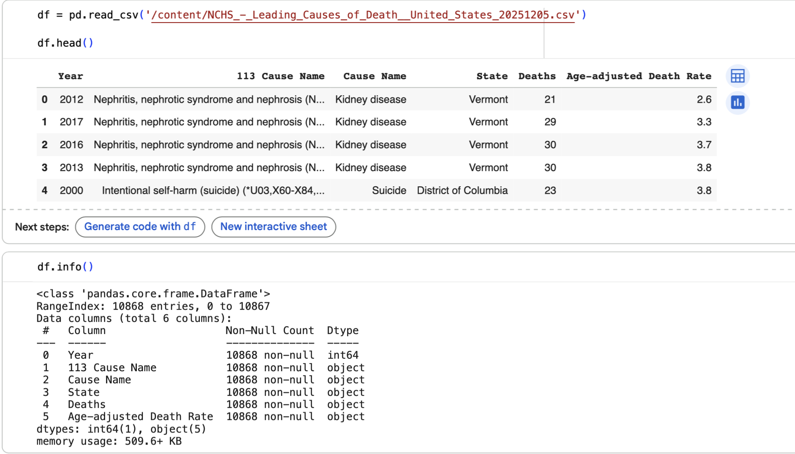

Slide 4
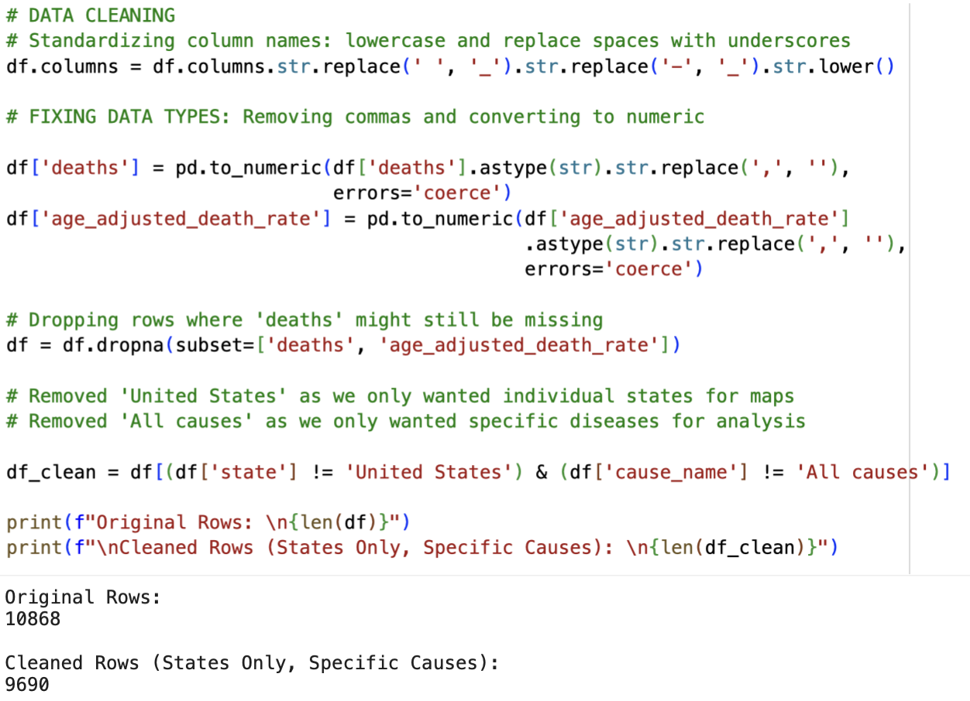
Data Cleaning & Preparation
Standardized column names: lowercase, underscores instead of spaces
Removed commas and converted deaths and age_adjusted_death_rate to numeric
Dropped rows with missing values in key numeric fields
Filtered out summary rows for United States and All causes
Created a cleaned DataFrame df_clean

Slide 5
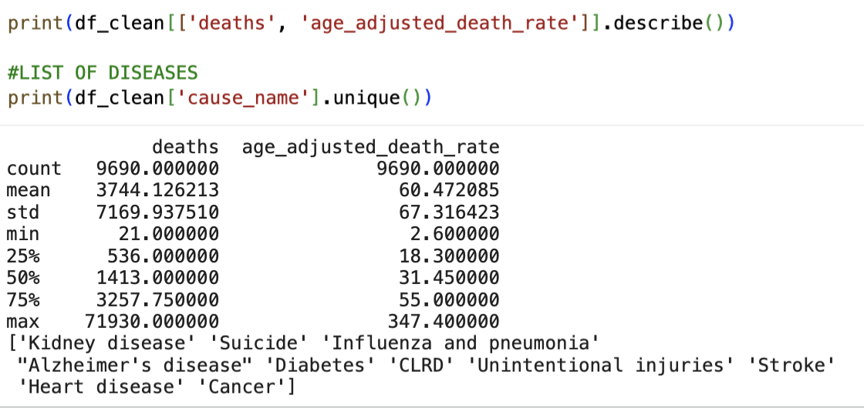
Descriptive Statistics
Summarized key numeric columns: deaths, age_adjusted_death_rate
Looked at min, max, mean, median, and quartiles
Listed all unique leading causes of death in the dataset
This helps understand typical and extreme death rates

Slide 6
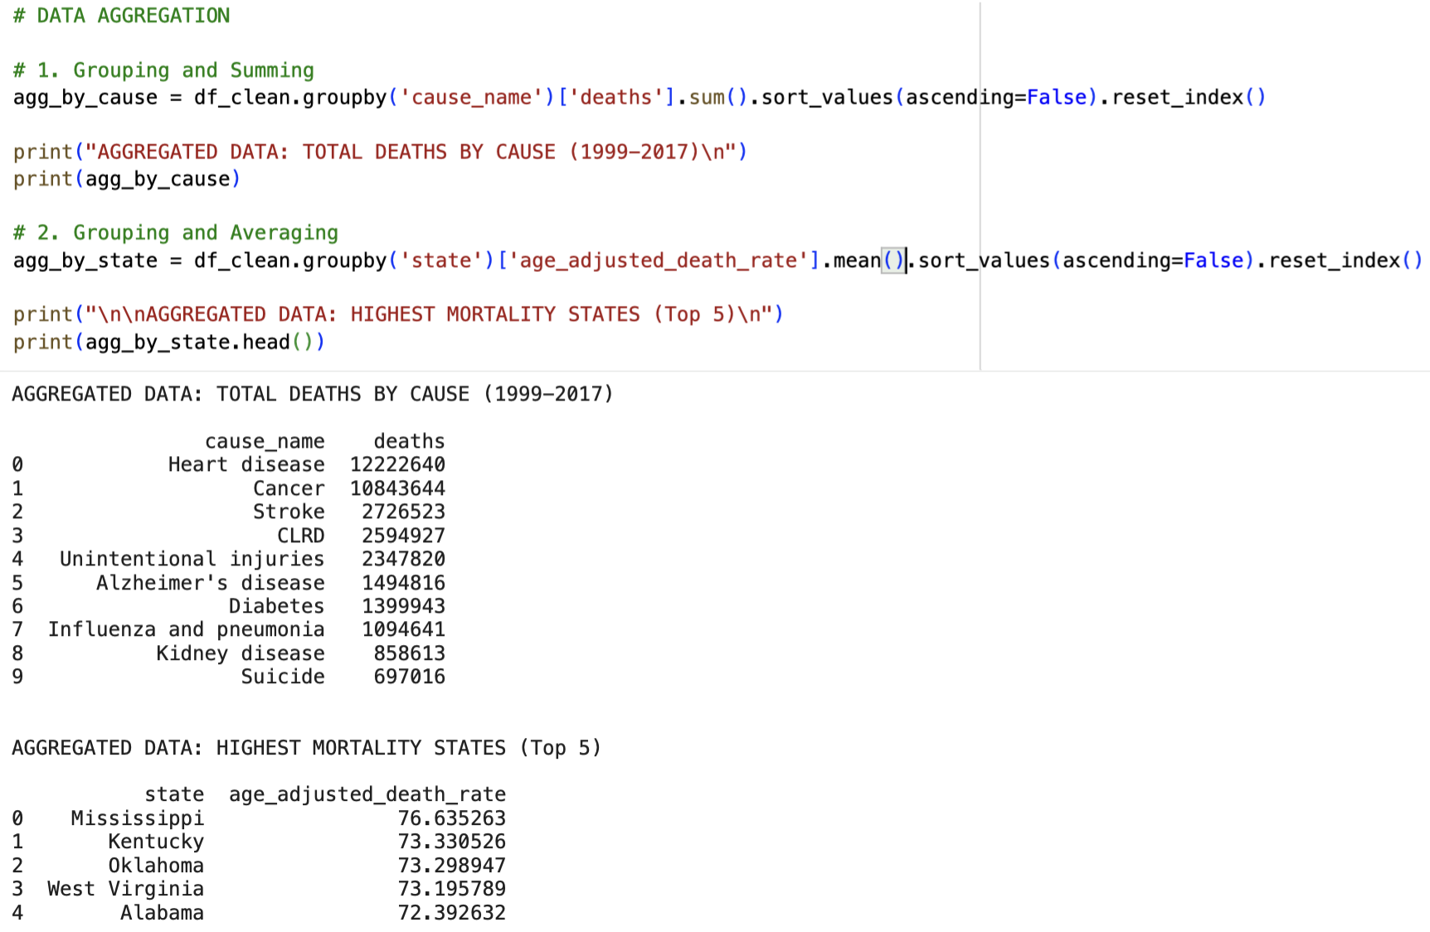
Data Aggregation: By Cause and By State
Question 1: Which causes of death have the highest total deaths overall?
Question 2: Which states have the highest average age-adjusted death rates?
Grouped data by cause_name and by state using groupby()
Sorted results to identify the highest values

Slide 7
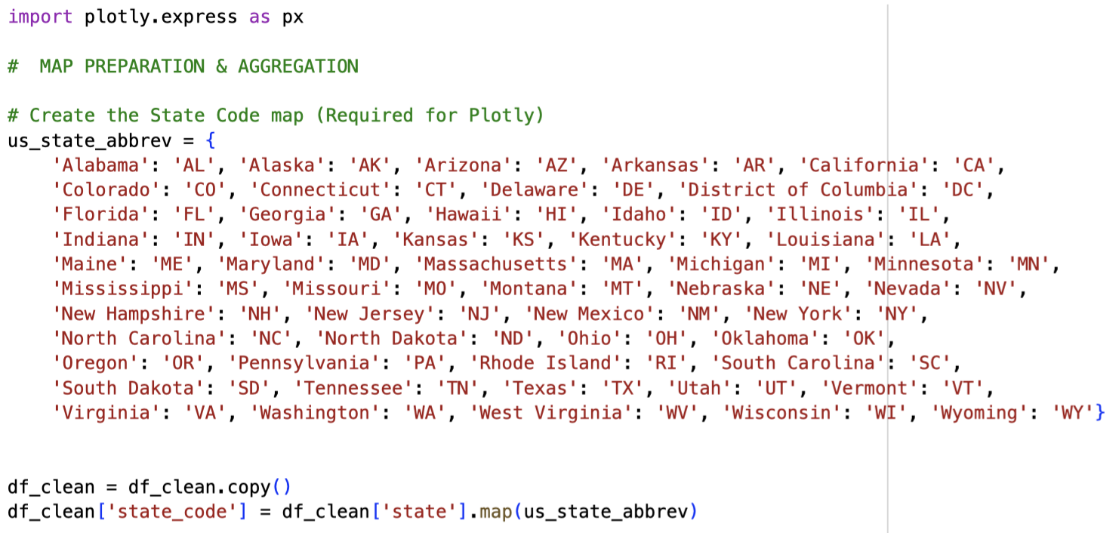
Map Visualization : Preparation

Slide 8
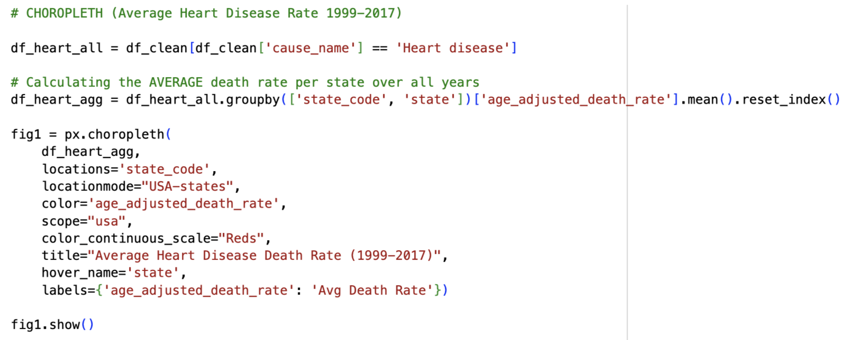
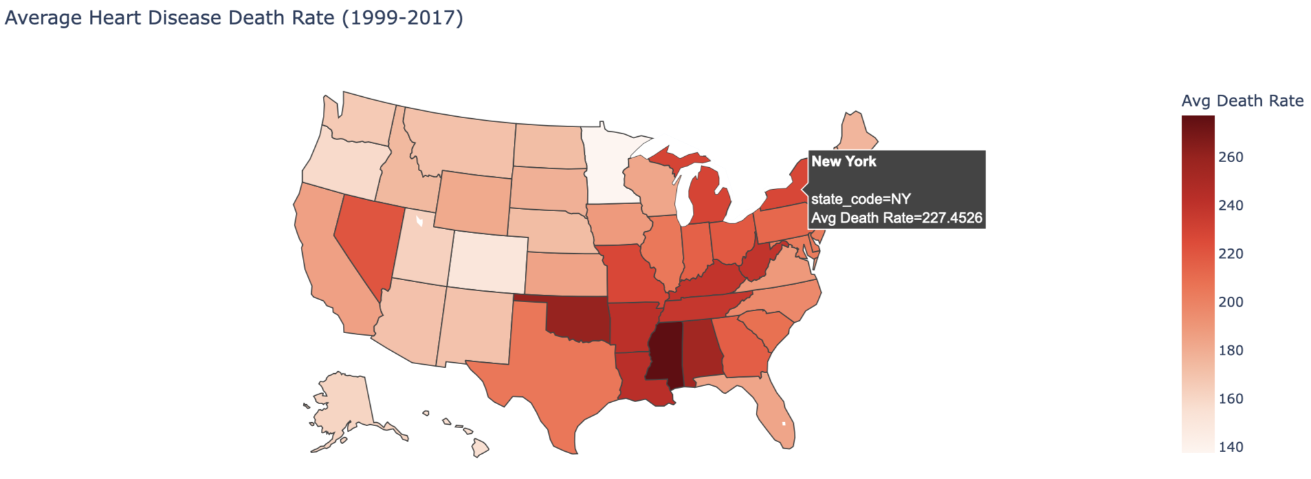
Map Visualization 1: Choropleth (Heart Disease)
Focused on Heart disease, one of the leading causes of death
Calculated average age-adjusted death rate per state (1999–2017)
Mapped states using two-letter state codes
Darker colors indicate higher death rates

Slide 9
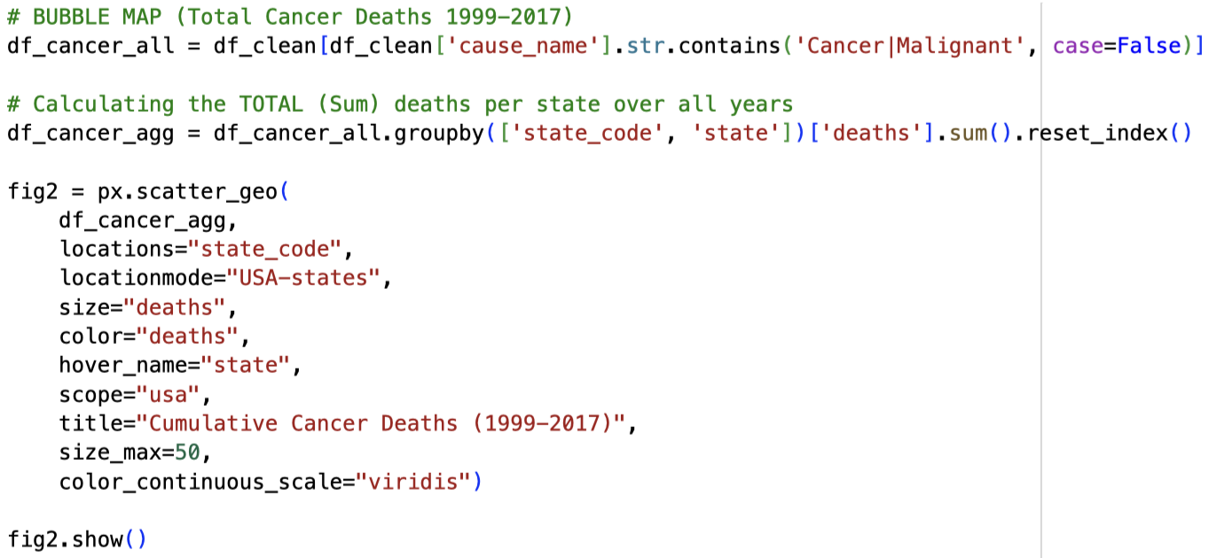
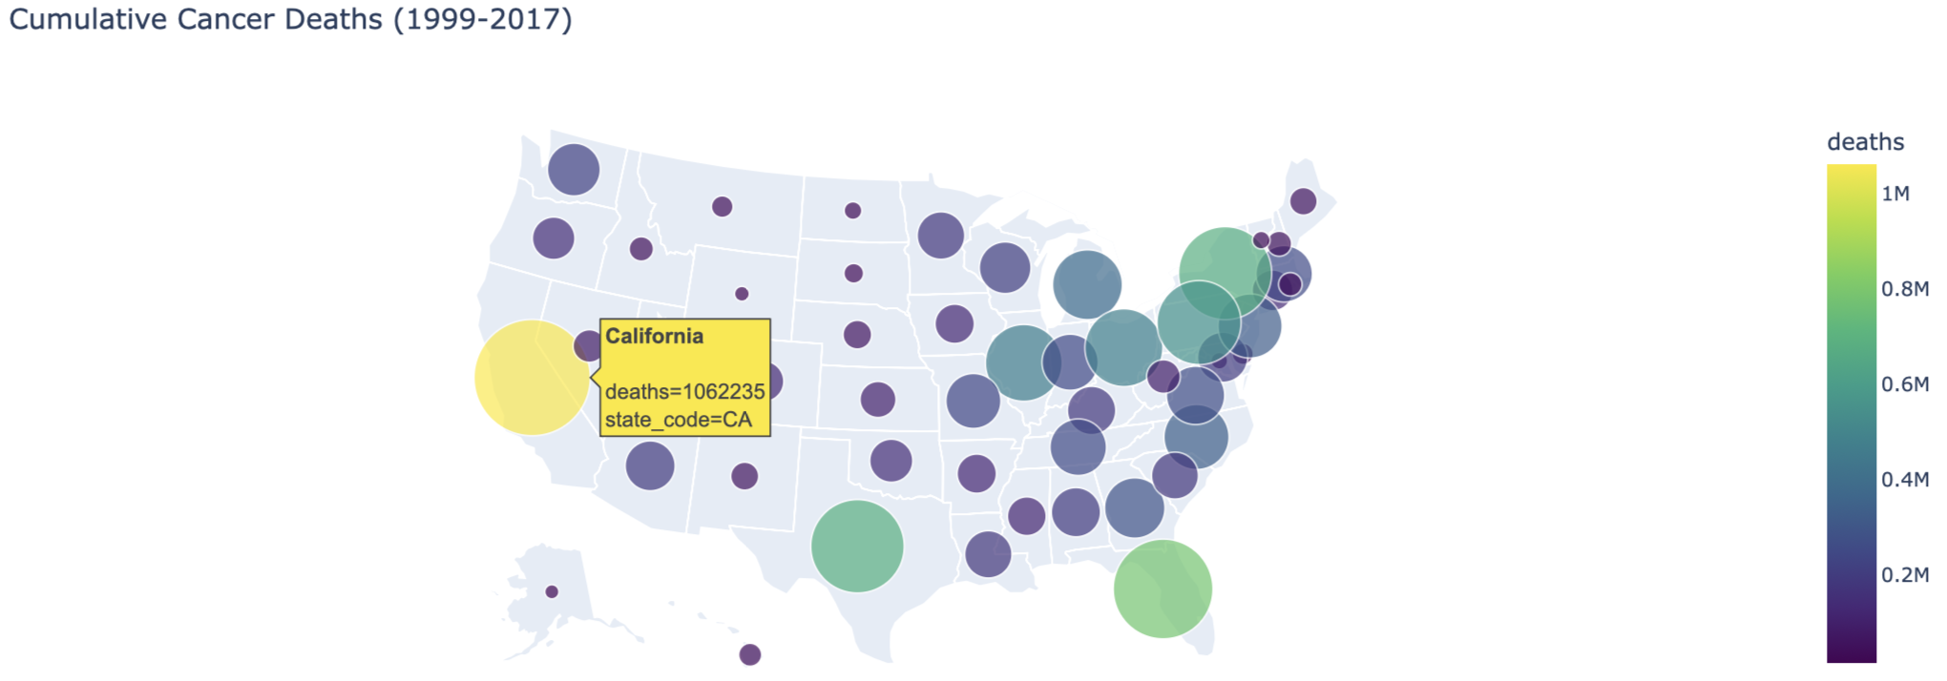
Map Visualization 2: Bubble Map (Cancer)
Focus on Cancer and malignant neoplasms
Calculated total deaths per state across all years
Represented each state as a bubble on the U.S. map
Bubble size and color both reflect the total number of cancer deaths

Slide 10
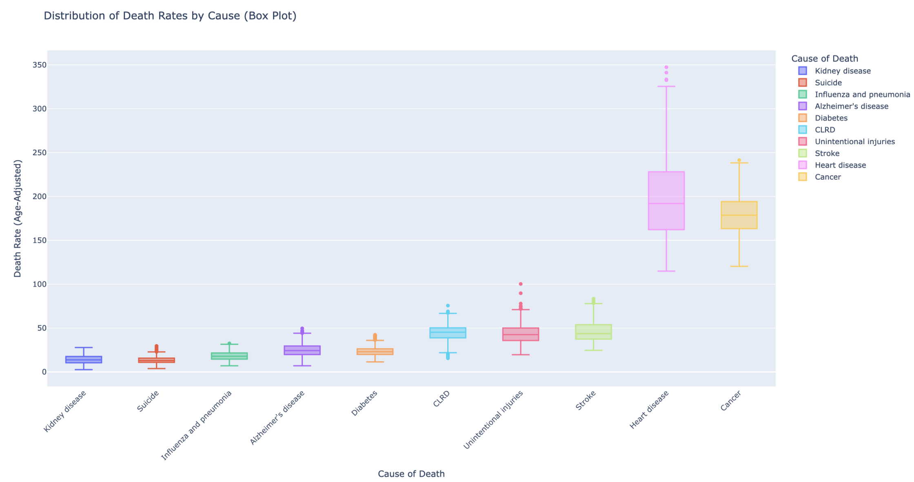
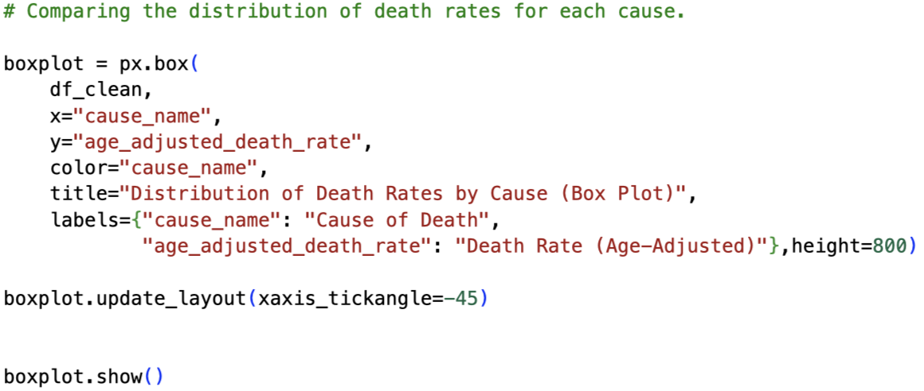
Aggregation Visualization 1: Box Plot by Cause
Box plot of age-adjusted death rates by cause_name
Each box shows median and spread of death rates over time across states
Helps compare variability between different diseases
Some causes have much wider ranges than others

Slide 11
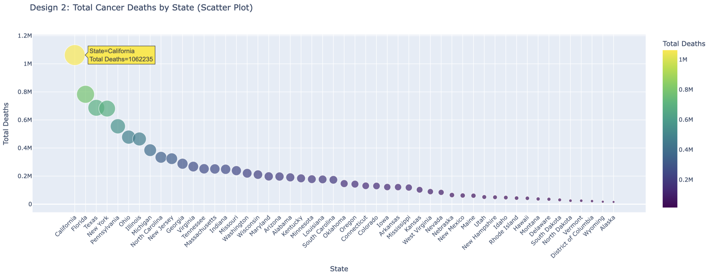
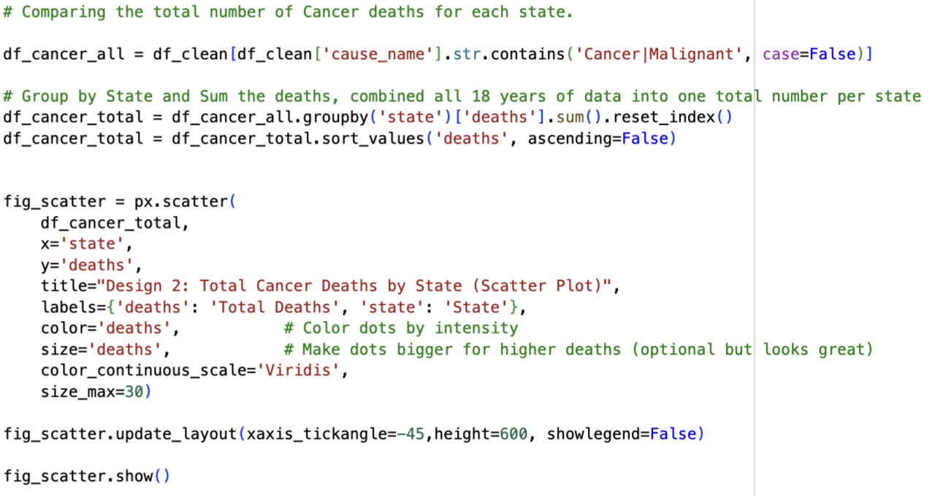
Aggregation Visualization 2: Scatter Plot (Cancer by State)
Aggregated total cancer deaths per state (1999–2017)
Sorted states from highest to lowest
Scatter plot with point size and color representing total deaths
Makes it easy to see which states are at the top of cancer mortality

Slide 12
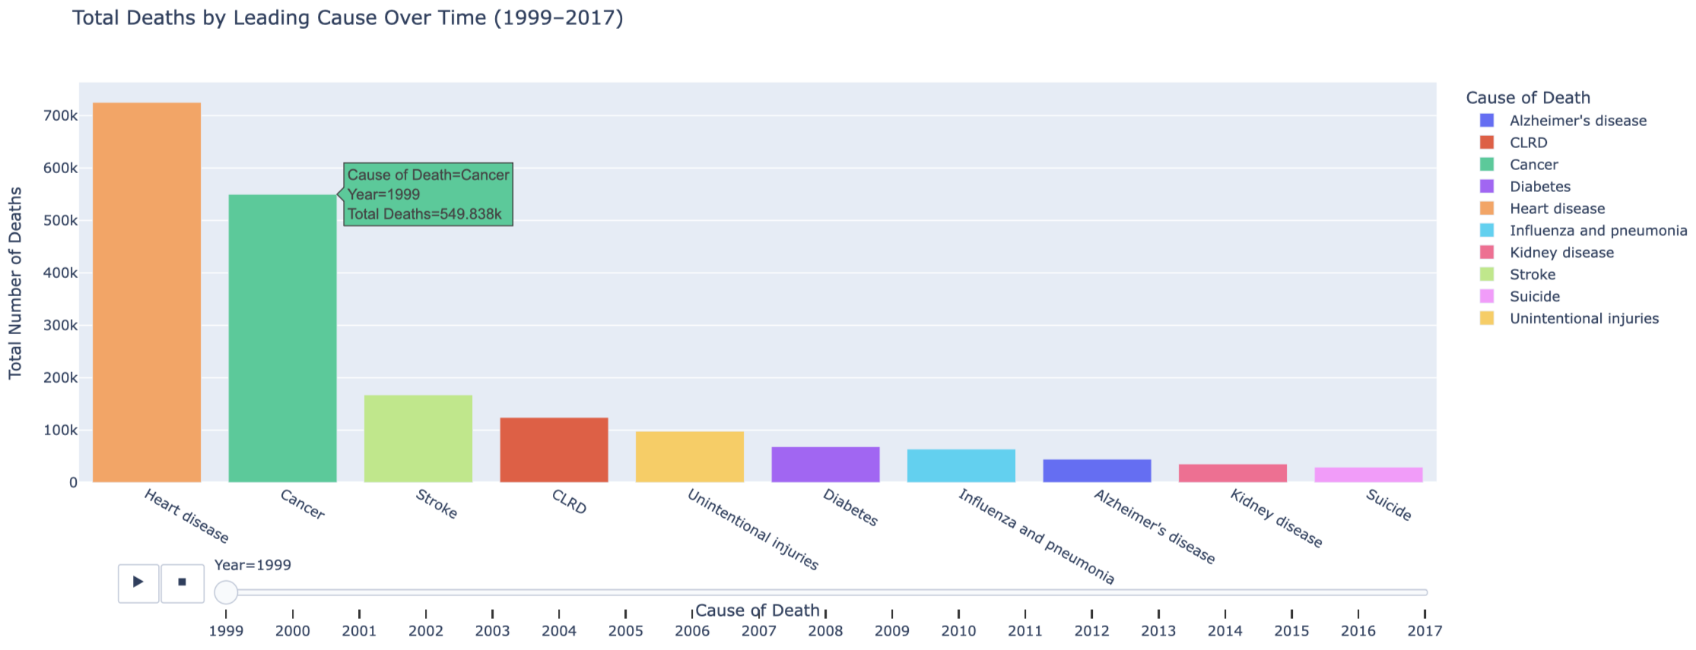
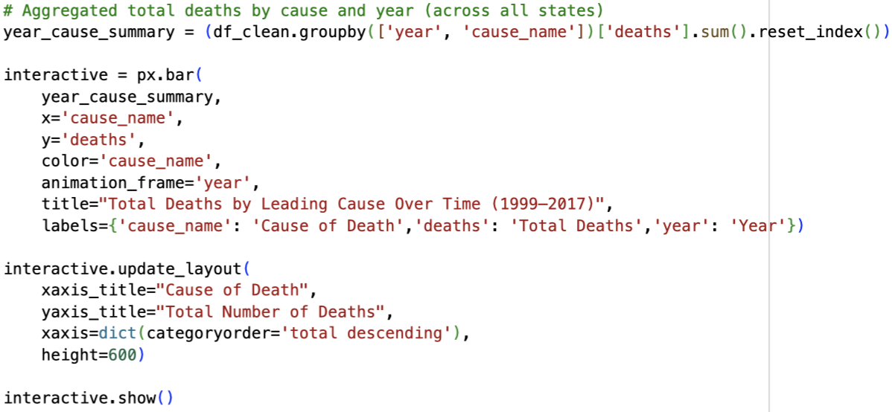
Interactive Visualization 1: Time-Series Bar Chart
Aggregated total deaths by year and cause_name
Built an animated bar chart using Plotly
Each frame shows a specific year from 1999 to 2017
Includes a slider and play button to scrub through time
Shows how the ranking of causes changes (or stays stable) over time

Slide 13
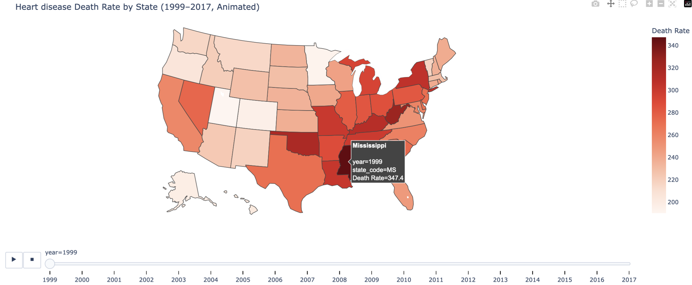
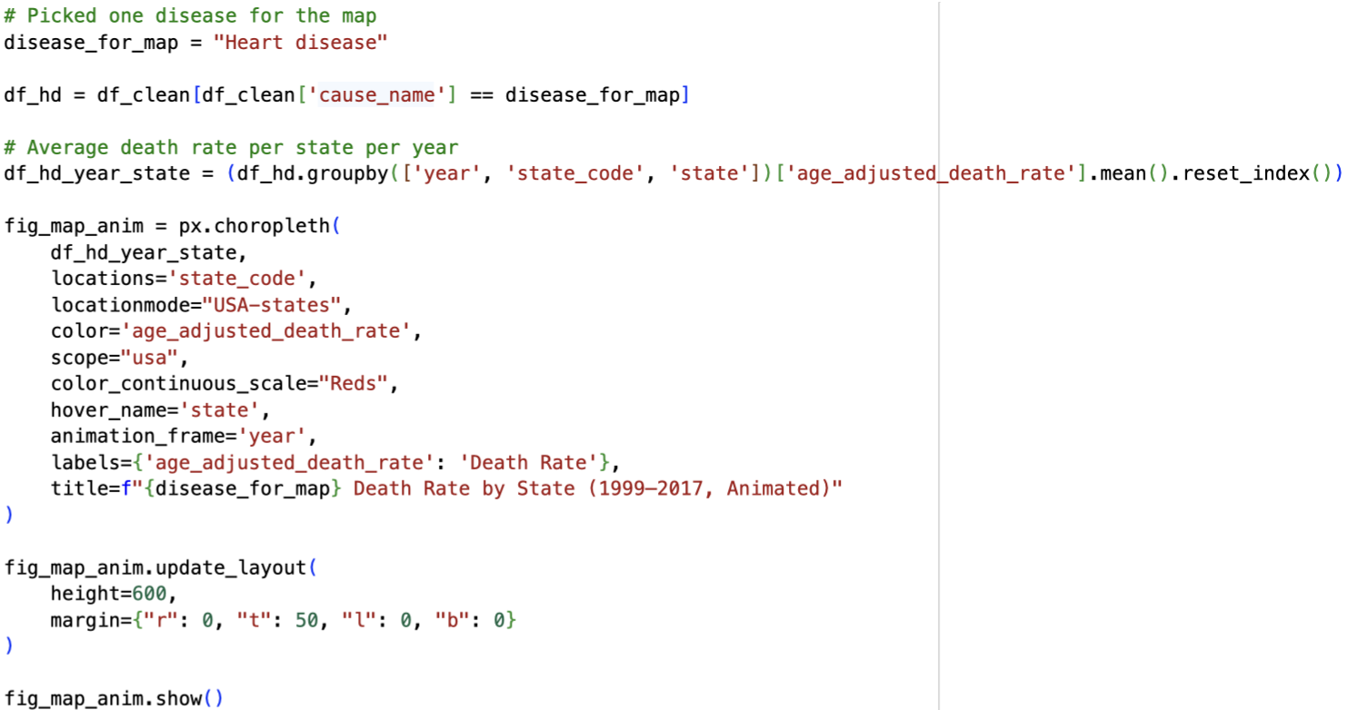
Interactive Visualization 2: Animated Choropleth Map
Focuses on Heart disease death rates across states
Aggregated average age-adjusted death rate per state for each year
Uses an animated choropleth map of the United States
Year slider + play button let us scrub through 1999–2017
Hover interaction shows the exact state name and death rate

Slide 14
Conclusions and Observations
Heart disease and cancer consistently appear among the top causes of death
Certain states show higher average death rates for major causes
Cancer deaths are concentrated in a subset of states with large populations
The time-series visualization shows that the ranking of leading causes is relatively stable, with some fluctuations
The combination of maps, aggregation plots, and interactive views helps connect geographic patterns with overall mortality trends

